Slide 1
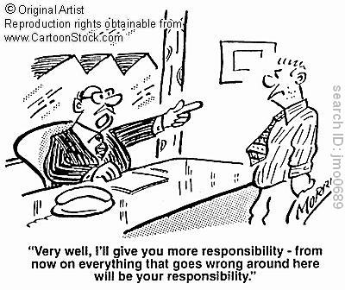

Slide 3
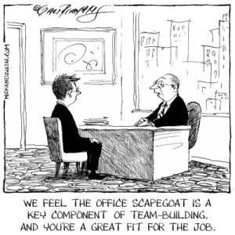

Slide 4
John 1:29-34
Look, the Scapegoat!
Has He taken away your sin?
Has He baptized you with His Holy Spirit?

